Slide 1
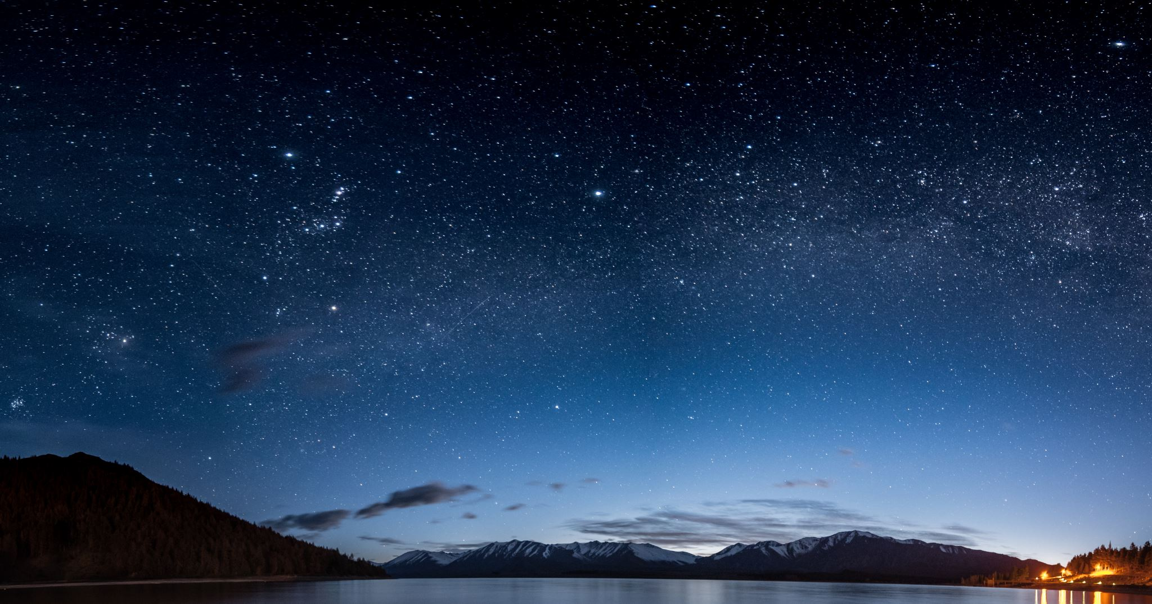
UFO and Meteors Capstone
By: Wiley Martin

Slide 2
Technologies Used
Microsoft Excel
Python (Geospatial)
Power BI

Slide 3
Agenda
Data Question
Known Issues / Challenges
Findings
Conclusion

Slide 4
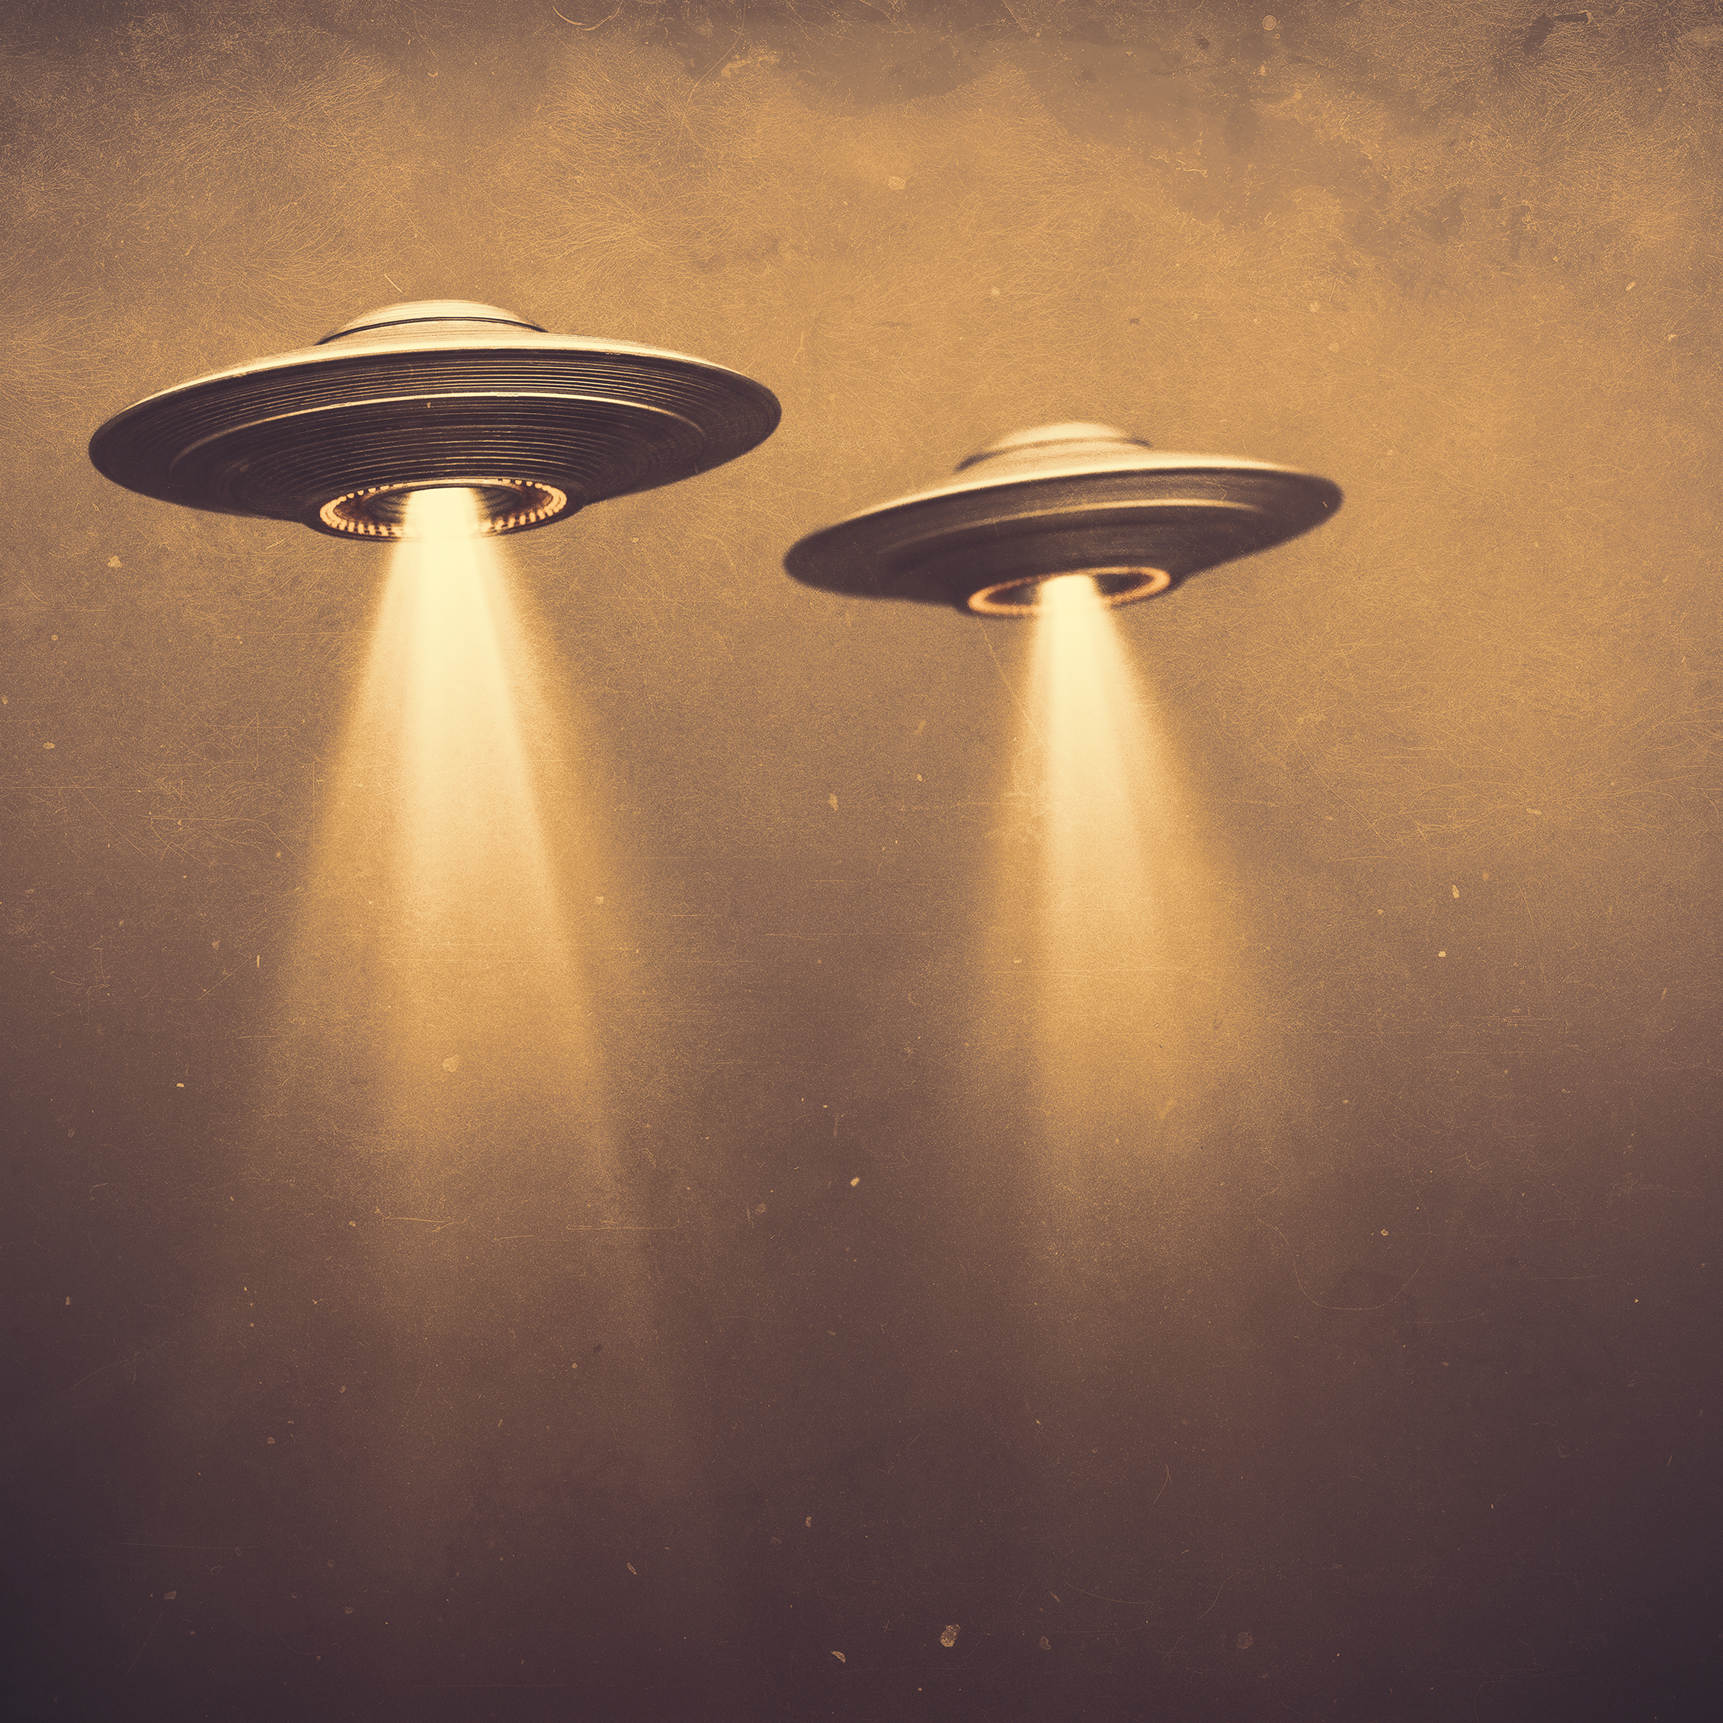
Data Question
Is there a correlation between the location of meteorite fallings and the count of UFO sightings in certain areas of the country?

Slide 5

Potential/Known Issues
Issues of credibility behind sightings of the UFOs
Inaccuracy of UFO location sightings
Missing Data
Invalid time date formats in datasets

Slide 6
UFOs Over the Years

Slide 7
Different Types of UFOs

Slide 8
UFO Count Per Country

Slide 9
UFOs Per State

Slide 10
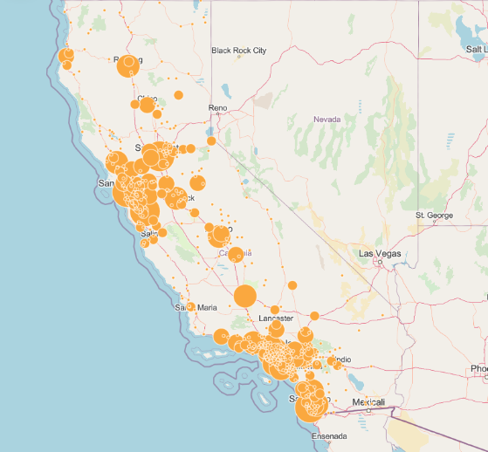
UFOS in California
Sacramento, California
San Francisco, California
Los Angeles, California
Long Beach, California
San Diego, California

Slide 11
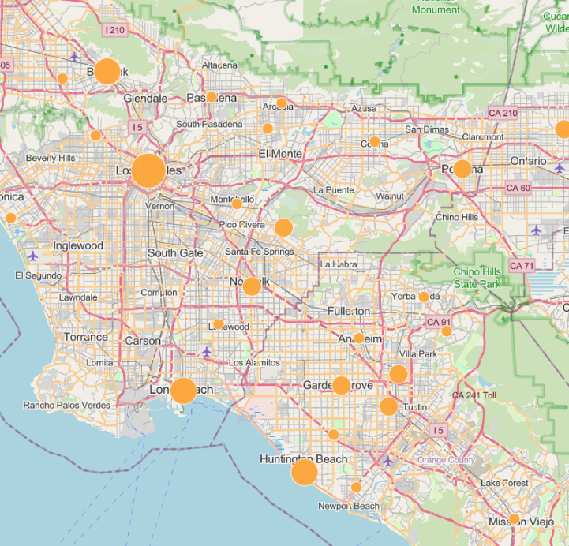
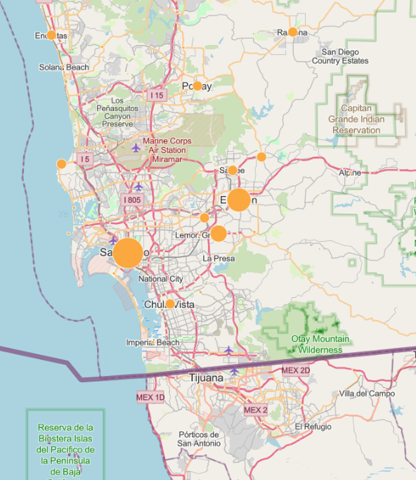
Airports ?

Slide 12
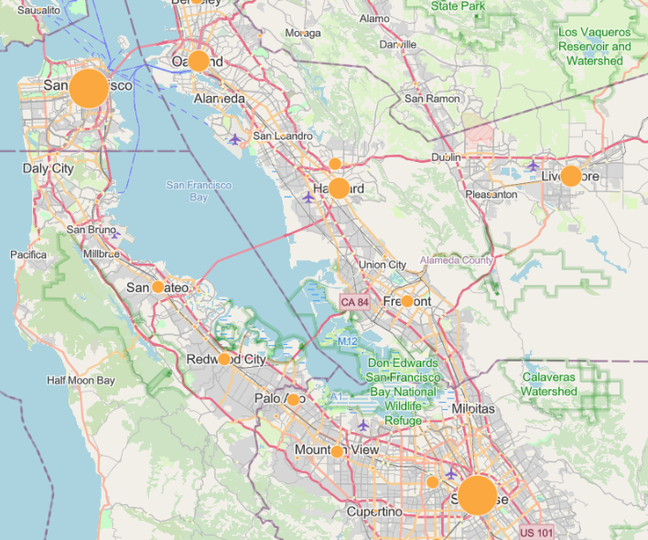
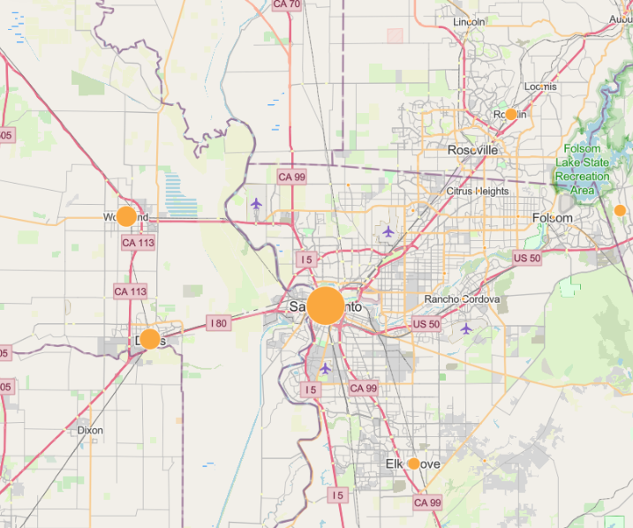
Airports ?

Slide 13
Meteor Information

Slide 14
Meteors Over the years

Slide 15
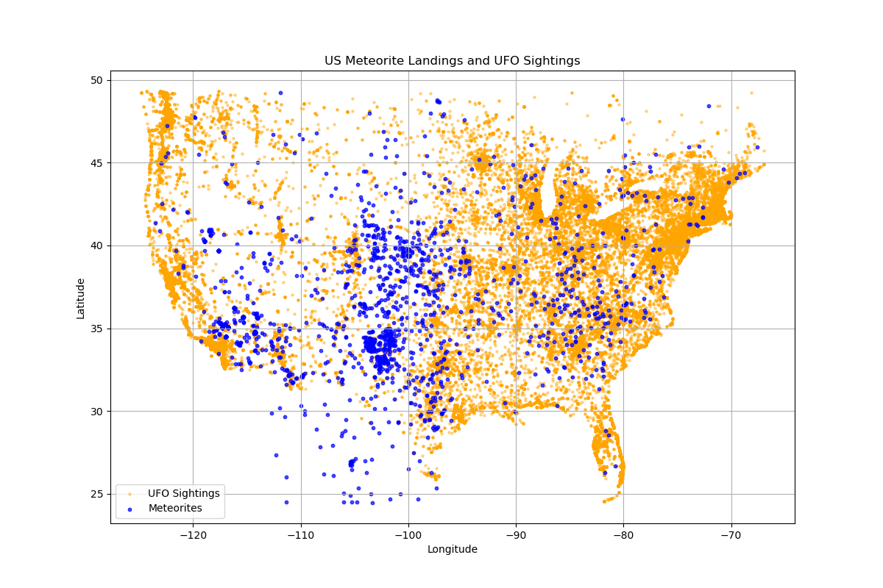
UFOs in Relation to Meteor locations in U.S.

Slide 16
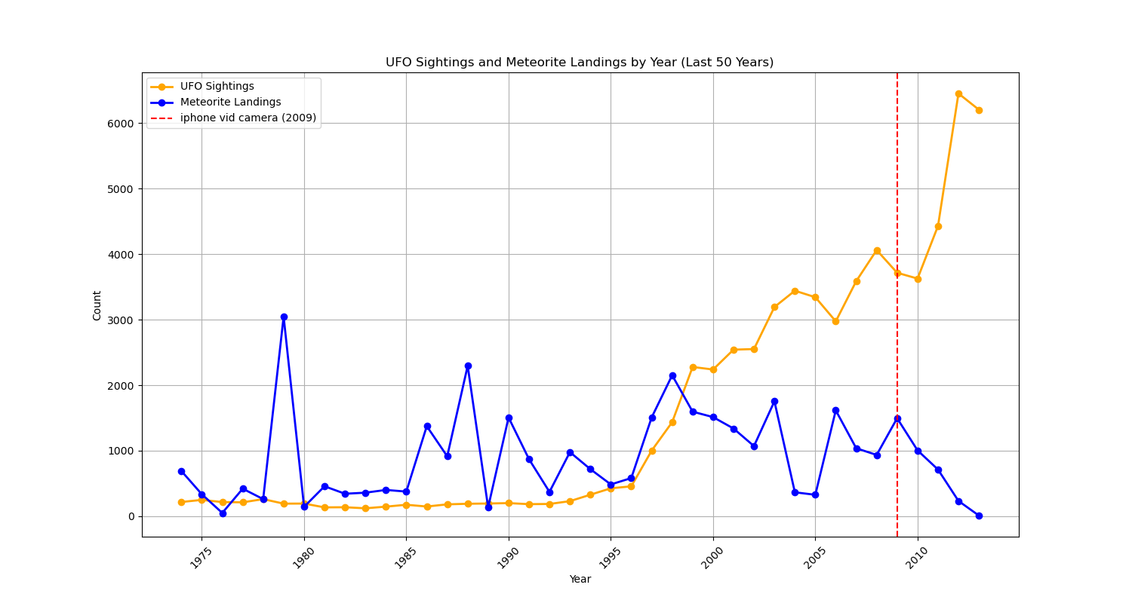
Influence of the Iphone ?

Slide 17
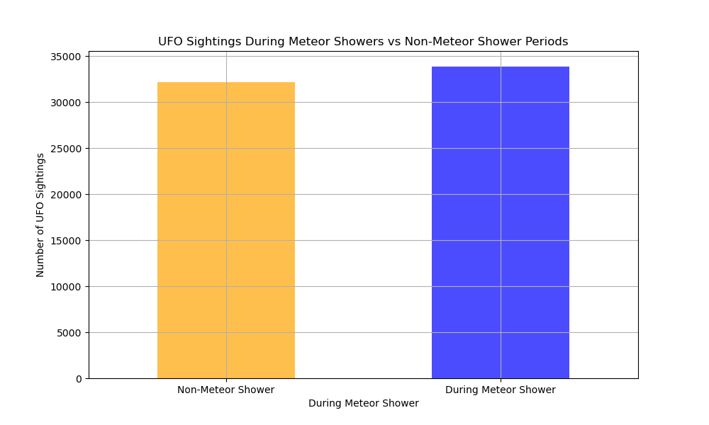
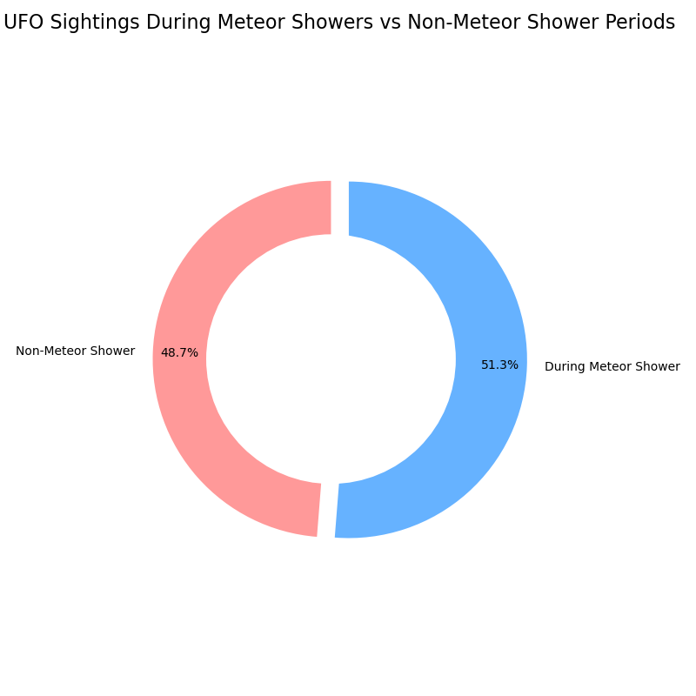
Influence of Meteor Showers on UFO Sightings ?

Slide 18
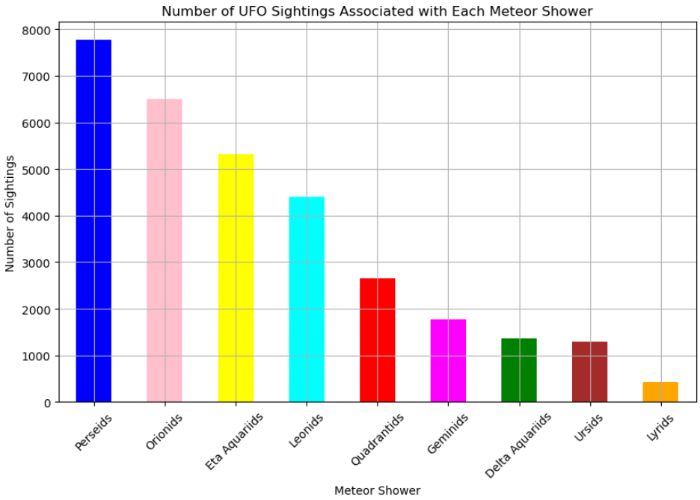
Meteor Showers Over the years

Slide 19
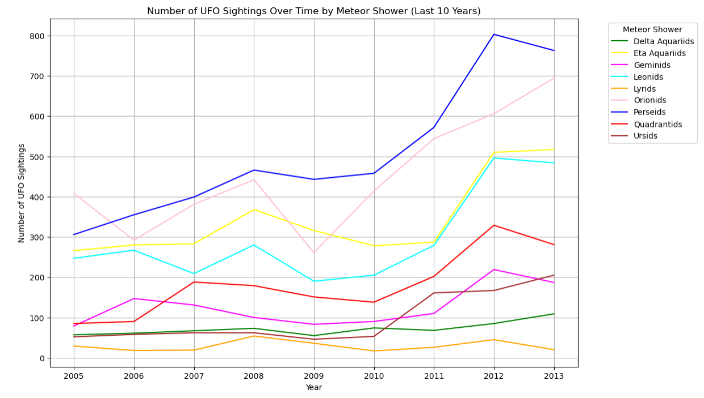
Meteor Showers Over the years

Slide 20
Conclusion
Not Enough positive correlations to be drawn between the two variables
The graphs presented display this negative correlation
The percentage of UFO sightings during meteor showers is roughly 50/50 to UFO sightings not during meteor showers
Years in which there were large spikes of meteor showers/meteors being found occasionally had no UFO sightings
UFO sightings spiked post 2009 which was the invention of the iPhone, could this indicate false sightings/clickbait given there were not many sightings before this ?
The cities in California with large bubble sizes of UFO sightings were largely near airports, false sightings again ?

